Slide 1

Machine Learning Operations
Session 5
Sandra Pico Oristrell
December 2023

Slide 2
Agenda
Part 1: Theory (2:15h)
Introduction to Machine Learning
Machine Learning in Production: Machine Learning Operations (MLOps)
ML Lifecycle
ML pipelines: Training and Inference
ML Deployment
ML Monitoring
MLOps at organization level
MLOps Maturity Level
Machine Learning on AWS
AWS Machine Learning Services
(30 min) Use case: MLOps foundation roadmap for enterprise with Amazon SageMaker.
Resources
Break (15 min)
Part 2: Hands-on (30min)
Lab: Build a Restaurant Chatbot with Amazon Lex

Slide 3
Part 1: Theory

Slide 4
Big Data on AWS
Session 5: Machine Learning Operations
Data Sources
Data Storage
Batch Processing
Analytics Storage
Reporting
Machine Learning
Real-time Ingestion or batch ingestion
Streaming processing

Slide 5
Introduction to Machine Learning

Slide 6
AI, ML and Deep Learning
Subsets of Artificial Intelligence (AI)
Artificial Intelligence is the broad term for teaching machines to think. Artificial Intelligence has subcategories for specific types of learning.
Example: Machines that can play chess based on rules.
Machine Learning is a subset of Artificial Intelligence where the computer program derives rules from the data itself. It uses variety of data that was collected in the past to uncover patterns that are hidden in that data. The patterns are then used to create a model, which is applied to new data to provide a more well-informed and adaptative prediction.
Example: Inventory forecasting.
Deep Learning is a subset of Machine Learning that uses large volumes of data and complex algorithms to train models, such as Neural Networks.
Example: Object detection in Images.
Artificial Intelligence
Machine Learning
Deep Learning

Slide 7
Machine Learning Terminology
Machine Learning: Key Concepts
A Model in ML is the trained algorithm that you use to identify patterns in your data. A model is trained through the ML process and captures and stores patterns. The more patterns a model stores, the bigger it will become. ML model sizes are described in MB. The purpose of a model is to predict outcomes to new data inputs, based on previously observed patterns.
Inference is the process of making predictions using a trained model.
There are variety of instance types that support Machine Learning models depending on the use case of the model. Instance types comprise varying combinations of CPU, GPU, memory and storage and networking capacity. They give you the flexibility to choose the appropriate mix of resources for your applications. Instance types will be different at training time than at inference time.
Artificial Intelligence

Slide 8
Real-life applications for ML
Industries and use cases
Machine Learning can be applied in all industries and sectors that have reliable data. Some of the most common use cases where it is applied are the following:
Image Recognition
Speech Recognition
Sales Forecasting
E- commerce Product Recommendations
Inventory forecasting
The type of data and regulations of each industry delimit the type of models that Data Scientists use to solve their real-life applications.

Slide 9
Type of ML problems
Classification and Regression problems
Classification Problems
Regression Problems
Artificial Intelligence
Binary Classification
Multiclass Classification
Regression
Targets a variable as belonging in one class or another. The goal of training a binary ML model is to predict values that can only have one of two states.
Classify an observation into own of three or more categories. The goal is to predict values that belong to a limited, predefined set of permissible values.
Regression classification models map inputs to a continuous value, like an integer. The goal is to predict a numeric value (e.g., predicting the stock of a company).

Slide 10
ML Algorithm types
Algorithms categories
Machine Learning algorithms fall into three categories: supervised learning, unsupervised learning and reinforcement learning.
Supervised Learning
The model uses known inputs and outputs to generalize future outputs. It’s called supervised learning because there must be a supervisor (i.e., labeled training data).
Labeled images of dogs and cats
Prediction
(i.e., cat or dog)
ML inference
ML model
ML training
New image

Slide 11
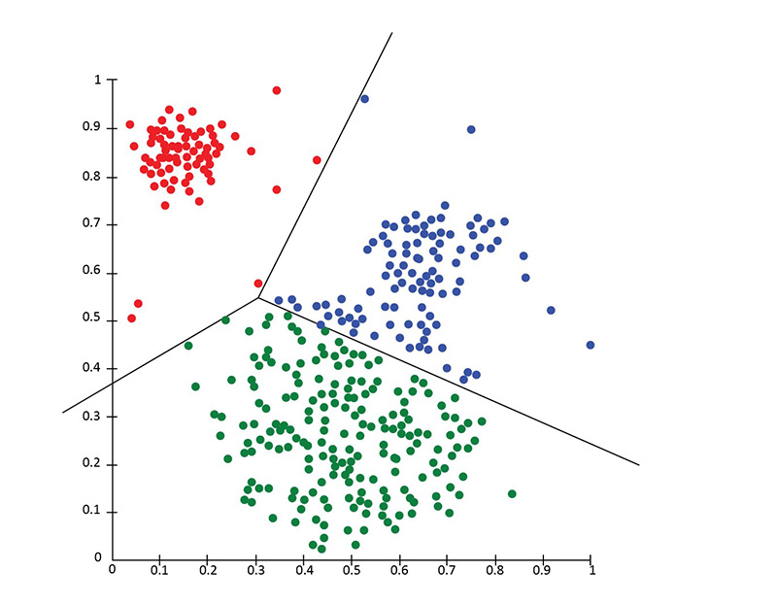
ML Algorithm types
Algorithms categories
Unsupervised Learning
The model doesn’t know inputs or outputs, so it find patterns in the data directly. In unsupervised learning, labels are not provided. A common subcategory of unsupervised learning is called clustering.

Slide 12

ML Algorithm types
Algorithms categories
Reinforcement Learning
This one continuously improves its model by mining feedback from previous iterations. An agent continuously learns, through trial and error, as it interacts in an environment. RL is useful when the reward of an intended outcome is known, but not how to achieve it.

Slide 13
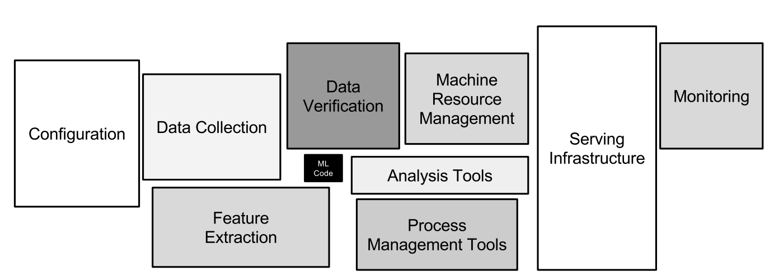
How do I move my ML model to Production?
Introduction to Machine Learning Operations
I learnt to train a Machine Learning model, now what?
[D. Sculley et. al. NIPS 2015: Hidden Technical Debt in Machine Learning Systems]

Slide 14
Machine Learning in Production
Machine Learning Operations (MLOps)

Slide 15
Machine Learning Operations (MLOps)
Definition
Machine Learning Operations (MLOps) is a set of processes and automation for managing models, data, and code to improve performance stability and long-term efficiency in Machine Learning (ML) systems. [1] Any MLOps solution must then not only consider the ML artifacts (i.e., models, data, code…) but also the various people and processes that interact with them.
MLOps includes the processes and tools from all the steps within the ML lifecycle, including data preparation, exploratory data analysis, feature engineering, model training, model validation, model deployment and monitoring.
[1] The big book of MLOps, Databricks

Slide 16
Machine Learning Life-cycle

Slide 17
Machine Learning Life-cycle
Life-cycle of a Machine Learning Problem: Steps of an ML Project
Scoping
Data
Modeling
Deployment
Business Problem
Definition
Analyze required data and evaluate it
Select ML model and evaluate its performance
Deploy the model to production and monitor it

Slide 18
Machine Learning Life-cycle
Life-cycle of a Machine Learning Problem: Steps on an ML Project
Scoping
Data
Modeling
Deployment
Business Problem
Definition
Analyze required data and evaluate it
Select ML model and evaluate its performance
Deploy the model to production and monitor it
ML Problem formulation
Collect and label data
Tune
the Model
Meets
business
Goals?
Yes
Exploratory Data
Analysis (EDA)
Feature
Engineering
Select and
Model Training
Model
Validation
Deploy
Model
Model
Monitoring
No
Re-train the model with new data

Slide 19
Machine Learning Life-cycle
Life-cycle of a Machine Learning Problem: Steps on a ML Project
Scoping
Data
Modeling
Deployment
Business Problem
Definition
Analyze required data and evaluate it
Select ML model and evaluate its performance
Deploy the model to production and monitor it
ML Problem formulation
Collect and label data
Tune
the Model
Data Engineer
Machine Learning Engineer
Meets
business
Goals?
Yes
Exploratory Data
Analysis (EDA)
Feature
Engineering
Select and
Model Training
Model
Validation
Deploy
Model
Model
Monitoring
No
Data Scientist
Business Stakeholder
Business Stakeholder
Re-train the model with new data

Slide 20
Machine Learning Life-cycle
Speech Recognition application use case
Scoping
Data
Modeling
Deployment
Business Problem
Definition
Analyze required data and evaluate it
Select ML model and evaluate its performance
Deploy the model to production and monitor it
Decide to work on speech recognition.
Decide on key metrics:
Accuracy: How accurate is my speech recognition system
Latency: How long does the system takes to transcribe speech to text.
Throughput: How many queries per second my system can handle.
Estimate resources (budget, compute, roles) and timeline

Slide 21
Machine Learning Life-cycle
Speech Recognition application use case
Scoping
Data
Modeling
Deployment
Business Problem
Definition
Analyze required data and evaluate it
Select ML model and evaluate its performance
Deploy the model to production and monitor it
Define data
Is the data labeled consistently?
How much silence before/after each clip?
How to perform volume normalization?
Organize the data
How should the data be organized to be able to train, test and validate my model?

Slide 22
Machine Learning Life-cycle
Speech Recognition application use case
Scoping
Data
Modeling
Deployment
Business Problem
Definition
Analyze required data and evaluate it
Select ML model and evaluate its performance
Deploy the model to production and monitor it
ML Model:
Select the algorithm
Select the hyperparameters
Select the data
Define the error analysis
Validate your model before deploying it

Slide 23


Machine Learning Life-cycle
Speech Recognition application use case
Scoping
Data
Modeling
Deployment
Business Problem
Definition
Analyze required data and evaluate it
Select ML model and evaluate its performance
Deploy the model to production and monitor it
Mobile phone (edge device)
Trained model hosted
in a Server
Speech API
Local software
Predict Server
VAD
module
Microphone
Transcripts
Speech Recognition
Trained Model
Frontend code

Slide 24
Machine Learning Pipelines
Training and inference pipeline

Slide 25
Machine Learning Pipelines
Training pipeline
Deployment of the model
Inference pipeline

Slide 26
Machine Learning Pipelines
Training pipeline
A machine learning training pipeline is a series of steps that automate and standardize the process of training the ML model.
Input
data sources
Feature
Engineering
ML Model
training
Trained ML model
No. Then, optimize the
model parameters and/or
feature engineering logic.
ML validation
Yes. Then, your
trained model is ready.
Meets criteria?

Slide 27
Machine Learning Pipelines
Training pipeline technical considerations
Input data sources usually come from Tier 2 layer in the Data Lake.
The output of the feature engineering steps is usually stored in the Tier 3 layer in the Data Lake.
The Feature Engineering is usually performed as a batch processing job.
The ML model is saved in an object-storage (or similar) and registered in a Model Registry.
Training pipelines are triggered on-schedule or on-demand. It depends on the ML model performance and the use case.

Slide 28
Machine Learning Pipelines
Trained ML model
When you have a trained Machine Learning model, you adjust or change the parameters (or weights) of the model so its performance in solving a certain task is optimized. Either when you apply Deep Learning and leverage Neural Networks, or you leverage traditional machine learning methods, what you are trying to do is map an approximate function between input and output. When training, you try to get those parameters of the function and use those parameters during inference to predict output for the new unseen inputs.
Often, models can be saved in a file that can potentially be compressed, so typically model files have a binary file format.
TensorFlow saves models as protocol buffer files (.pb extension). Keras saves models natively as a .h5 file. Scikit-Learn saves models as pickled python objects, with a .pkl file extension. PyTorch recommend to save their models as a .pt or .pth file extension.

Slide 29
Machine Learning Pipelines
Inference pipeline
After you train a Machine Learning model, you need to deploy it so that others can consume its predictions. Such execution mode of a model is called inference.
Input data
Pre-processing step
Get predictions
Post-Processing step
Trained model

Slide 30
Machine Learning Pipelines
Inference pipeline
Real-time inference pipeline
Inference pipeline
Batch inference pipeline

Slide 31
Machine Learning Pipelines
Inference pipeline: Real-time inference pipeline
You can use trained models in an inference pipeline to make real-time predictions. A real-time inference pipeline is configured for real-time inference that generates predictions on-demand as you invoke the provisioned API.
The trained model is then hosted into a persistent endpoint. A real-time endpoint is a set of resources and compute required for hosting your model that does the actual inferencing.
Trained model hosted
in a Server
API
Predict Server
Application
ML Model
Predictions
The server can either be in the Cloud or at the Edge.

Slide 32
Machine Learning Pipelines
Inference pipeline: Real-time inference pipeline
Inference pipeline hosted into a real-time persistent endpoint behind an API
Application
Pre-processing step
Get predictions
Post-Processing step
Input payload
Trained model
Output payload with predictions

Slide 33
Machine Learning Pipelines
Inference pipeline: Batch inference pipeline
Batch inference is used on large volumes of data over in asynchronous way. Once the predictions are done, you store them into a data store for further analysis. Batch inference is used when you do not have low latency requirements, but you still need to perform inference over large amount of data.
The compute resources needed are automatically provisioned when the job starts, and automatically de-allocated as the job completes. You only pay for the compute when you use it.

Slide 34
Machine Learning Pipelines
Inference pipeline: Batch inference pipeline
The resources needed are provisioned when the job starts
Input dataset
Pre-processing step
Get predictions
Post-Processing step
Output dataset
Trained model

Slide 35
Software Engineering Issues
Deployment of a model into a Software Application
Checklist of questions
Realtime or Batch
Cloud vs Edge
Compute resources (CPU/GPU/Memory)
Latency, throughput (QPS)
Logging
Security and Privacy

Slide 36
Machine Learning Monitoring

Slide 37
ML Monitoring
When a Machine Learning model is deployed in production, you need to set up continuous monitoring for a real-time endpoint, or on-schedule monitoring for asynchronous batch inference jobs. When it comes to monitoring Machine Learning, there are different types of monitoring.
Monitor data quality
Monitor model quality

Slide 38
ML Monitoring
Monitor drift in data quality
Data quality monitoring automatically monitors machine learning models in production and notifies you when data quality issues arise. If the statistical nature of the data that your model receives while in production drifts away from the nature of the baseline data it was trained on, the model begins to lose accuracy in its predictions.
Training data
Generate baseline statistics constraints
Save statistics for training data
Production data
Compute the statistics to the production data. Compare them with the statistics in training data
Evaluate data drift

Slide 39
ML Monitoring
Monitor drift in model quality metrics
Model quality monitoring jobs monitor the performance of a model by comparing the predictions that the model makes with the actual ground truth labels that the model attempts to predict. To do this, model quality monitoring merges data that is captured from real-time or batch inference with actual labels that you store, and then compares the predictions with the actual labels.
Requests and predictions
Compute model quality metrics
Compare them with baseline model quality metrics
Inference ground truth

Slide 40
ML Monitoring
Evaluate model drift and data drift and decide if re-training is needed
Based on the performance obtained in the monitoring jobs for data drift or for model quality drift, the model should be re-trained with new training data.
The re-training might also occur based on schedule, independently of the performance obtained in the monitoring jobs. This will depend on the nature of the Machine Learning use case.

Slide 41
Machine Learning Operations
At Organization level

Slide 42
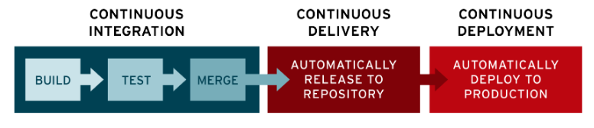
MLOps at organization level
CI/CD pipeline
A continuous integration and continuous deployment (CI/CD) pipeline is a series of steps that must be performed in order to deliver a new version of software. CI/CD pipelines are a practice focused on improving software delivery throughout the software development life cycle via automation.
What is a CI/CD pipeline? (redhat.com)

Slide 43
MLOps at organization level
DEV, STG and PROD environment
Tooling
Promote to STG
Promote to PROD
Code repository
Evaluate and manual approval
Unit test
Deploy the trained model
Stress and load tests
Evaluate and manual approval
Deploy trained model
DEV environment
STG environment
PROD environment
Training pipeline
Trained model
Trained model
Real-time endpoint
Trained model
Real-time endpoint
Model registry
Model registry
Model registry
Applications
Integration tests in STG
Invoke models from PROD
Centralized Data Lake
Tier 1
Tier 2
Tier 3

Slide 44
MLOps at organization level
Reduce time to market
To speed-up the deployment of multiple Machine Learning models and reduce the time to market, Organizations create templates that allow teams to provision the needed infrastructure for their MLOps solution by re-using Continuous integration and continuous deployment (CI/CD) pipelines already used by other teams.
The templates provisioned also provide examples of the training and inference pipelines. However, they can later be customized by the Machine Learning Engineers and Data Scientists to it suits their specific requirements.

Slide 45
MLOps Maturity Level

Slide 46
MLOps Maturity Level
How to implement MLOps in your organization
When establishing MLOps best practices across your organization, you try to enable processes across multiple Machine Learning use cases, ensuring standardization across your Data Science teams.
MLOps benefits
Faster time to market
Improved productivity
Efficient model deployment
AWS defines the MLOps maturity level of your organization as follows. For more information here.

Slide 47
MLOps Maturity Level
How to implement MLOps in your organization
MLOps Level 0
The data scientists typically hand over trained models as artifacts that the engineering team deploys on API infrastructure. The process separates data scientists who create the model and engineers who deploy it. Infrequent releases mean the data science teams may retrain models only a few times a year. There are no CI/CD considerations for ML models with the rest of the application code. Similarly, active performance monitoring is nonexistent.
MLOps level 1
MLOps level 1 aims to train the model continuously by automating the ML pipeline. In level 0, you deploy a trained model to production. In contrast, for level 1, you deploy a training pipeline that runs recurrently to serve the trained model to your other apps. Your engineering teams work with data scientists to create modularized code components that are reusable, composable, and potentially shareable across ML pipelines.In addition, you can manage metadata—like information about each run of the pipeline and reproducibility data.

Slide 48
MLOps Maturity Level
How to implement MLOps in your organization
MLOps level 2
MLOps level 2 is for organizations that want to experiment more and frequently create new models that require continuous training. It's suitable for tech-driven companies that update their models in minutes, retrain them hourly or daily, and simultaneously redeploy them on thousands of servers.
As there are several ML pipelines in play, a MLOps level 2 setup requires all of the MLOps level 1 setup. It also requires these:
CI/CD
A model registry for tracking multiple models

Slide 49
MLOps on AWS

Slide 50
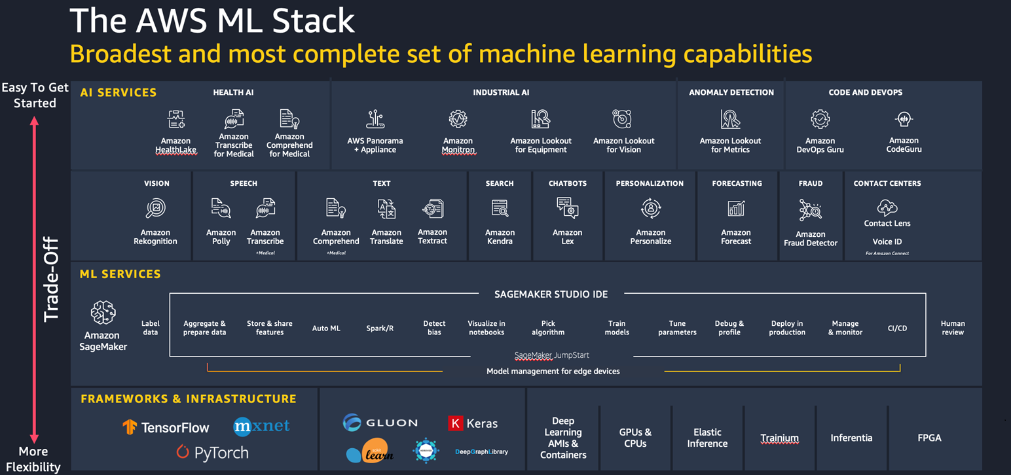
AWS Machine Learning Services

Slide 51
MLOps use cases

Slide 52

The MLOps use case
MLOps foundation roadmap for enterprises with Amazon SageMaker
MLOps foundation roadmap for enterprises with Amazon SageMaker | AWS Machine Learning Blog
Introduction and discussion time
30 min

Slide 53
Resources

Slide 54
Resources
The content of this section was based on the following resources:
AWS Educate Machine Learning Lab
DeepLearningAI: ML for Production
Amazon SageMaker developer guide
There are different tools on the market to implement the end-to-end pipeline for Machine Learning models. If you'd like to learn more about MLOps topics, the following resources are helpful for further learning:
Databricks and MLOps: Data-centric MLOps and LLMOps | Databricks
Amazon SageMaker (AWS) and MLOps: MLOps – Machine Learning Operations– Amazon Web Services
MLFlow Dive Deep: MLflow Documentation — MLflow 2.7.1 documentation
Deploy Machine Learning Models to Kubernetes: Kubeflow
DeepLearningAI courses: Courses - DeepLearning.AI

Slide 55
Part 2: Hands-on

Slide 56
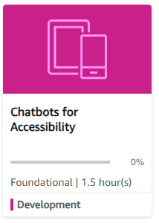
Hands-on Labs
AWS Educate Labs
1
Build a Restaurant Chatbot with Amazon Lex
Link
Course Modules: Chatbots for Accessibility (instructure.com)
Lab duration
~60 minutes (15 min to provision resources)
Description
Leverage Amazon Lex to build a Chatbot for your restaurant.

Slide 57
Thank you

